Slide 1
CHILDREN’S FOLKLORE
Дубленных Екатерина Владимировна,
Педагог дополнительного образования
МБОУ ДОД «Центр поддержки детства»
Екатеринбург, 2021

Slide 2
FOLKLORE
народ, народный
мудрость, знание

Slide 3
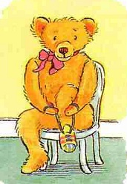
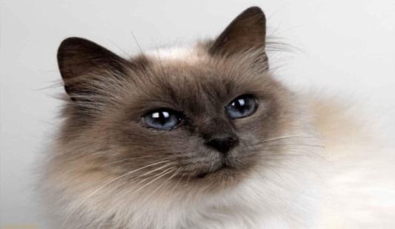
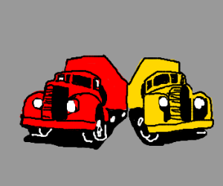

1. | Tastes differ . (О вкусах не спорят) .
2. | One, two, tie my shoe, Three, four, knock at the door.
3. | "Pussy-cat, pussy-cat, Where have you been?” "I’ve been to London To look at the Queen.”
4. | Red lorry, yellow lorry, red lorry, yellow lorry, red lorry, yellow lorry…
5. | White, but not snow. Sweet, but not ice-cream. What is it?

Slide 4
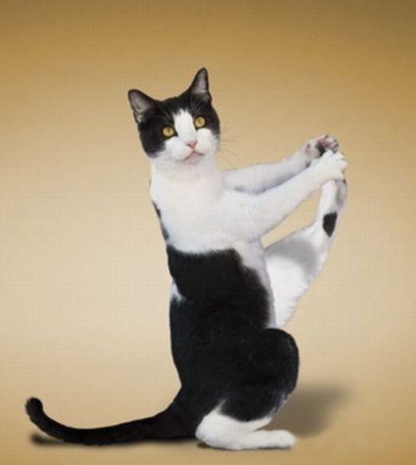

The P.T. break

Slide 5
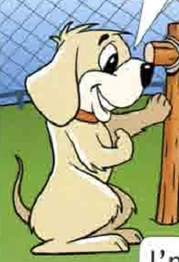
Arthur + Rascal

Slide 6
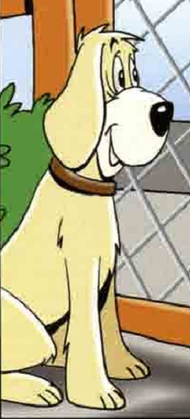

Slide 7
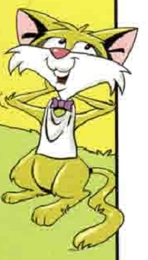

Slide 8
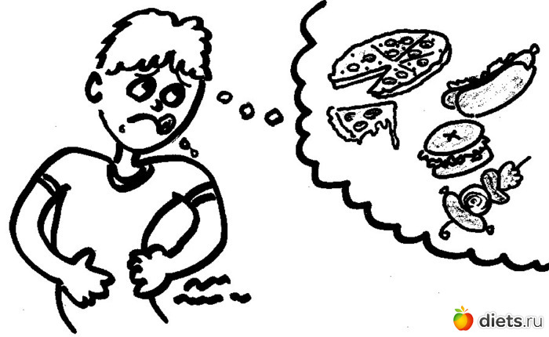
I’m hungry

Slide 9
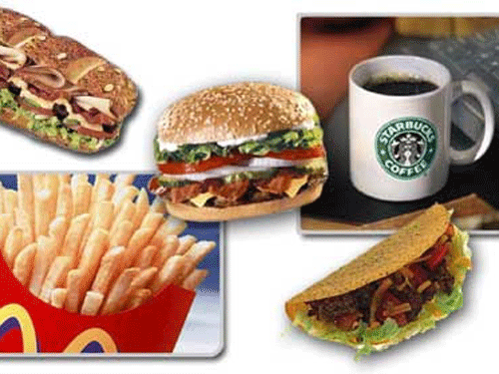
Fast food

Slide 10

I hate = I don’t like

Slide 11
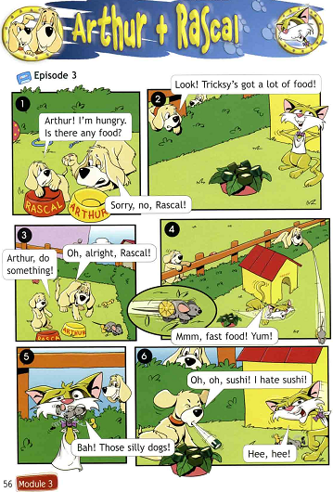

Slide 12
1. | Tastes differ . (О вкусах не спорят) .
2. | One, two, tie my shoe, Three, four, knock at the door.
3. | "Pussy-cat, pussy-cat, Where have you been?” "I’ve been to London To look at the Queen.”
4. | Red lorry, yellow lorry, red lorry, yellow lorry, red lorry, yellow lorry…
5. | White, but not snow. Sweet, but not ice-cream. What is it?

Slide 13
Tastes differ.
О вкусах не спорят.

Slide 14



The lesson

Slide 15
My progress

